Slide 1
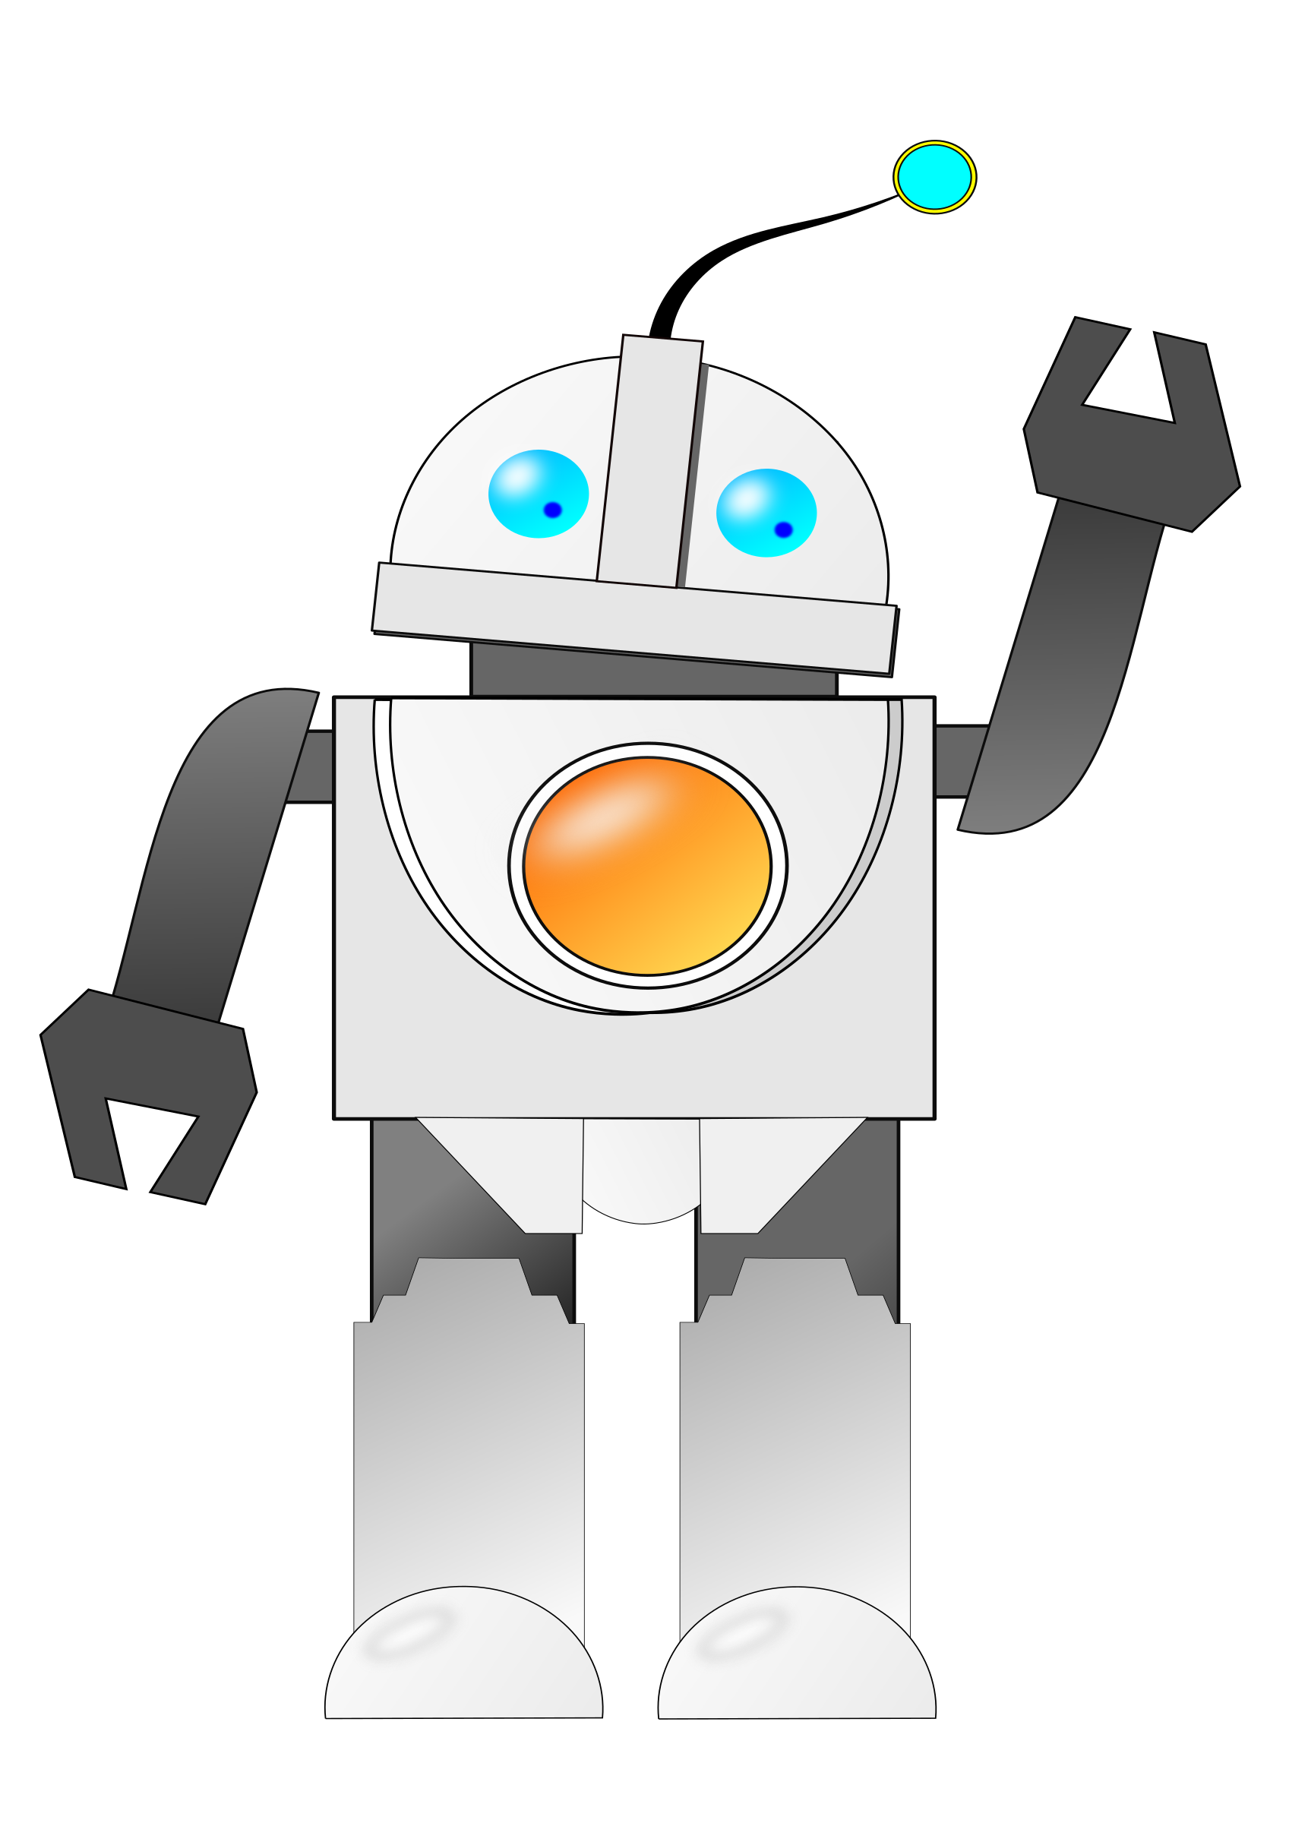



Response
Trained Bot
Request
User

